Slide 1
Induction Tutor / Lead Training Cambridgeshire and Peterborough Appropriate Body Service
Helen Thatcher
Cambridgeshire and Peterborough AB Lead

Slide 2
We know schools have a lot to do, and sometimes this may feel low priority, but the purpose of ECT induction is recruitment and retention. Those that do it best, often retain teachers and we want to keep teachers in your classrooms!

Slide 3
What is the Early Career Teacher Entitlement (ECTE)?
Early career teacher entitlement (ECTE) is a 2-year programme that supports early career teachers (ECTs) when they start their teaching career. It’s designed to:
develop their professional skills
provide them with the knowledge and skills to meet the teachers’ standards
It includes:
a training programme for ECTs
mentor support for ECTs
a training programme for new mentors (if the school uses a Department for Education (DfE) funded lead provider)
time off timetable for ECTs and mentors
regular progress reviews and 2 formal assessments for ECTs against the teachers’ standards
The term ‘early career teacher entitlement (ECTE)’ replaces ‘ECF-based training and induction’ from September 2025.
The statutory element of induction monitored and Quality Assured by the Appropriate Body

Slide 4
Becoming a teacher is a THREE-YEAR training programme. Year 1 - ITT Year 2 - ECT1 Year 3 - ECT2 Accepting an ECT, is accepting training them!
The continued commitment by the government is supporting this!

Slide 5
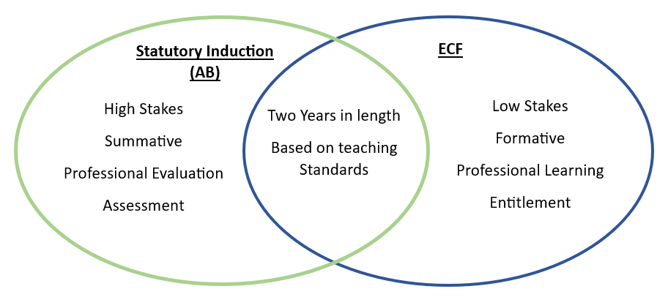
The Golden Thread
ECTP
(ITTECF)

Slide 6
Role of the Appropriate Body
Monitoring of Support:
Checking ECTs are receiving their statutory entitlements, and that regard is had to the statutory guidance
Provide fidelity checks, ensuring schools are supported to provide ECTs with an ECF-based induction
Monitoring of Assessment:
Quality Assurance of statutory induction
Supporting schools; especially where an ECT is causing concern
Reviewing and approving all progress reviews / assessment reports
Providing support to Induction Tutors
Making the final decision on the completion of induction

Slide 7
Role of the Appropriate Body
All ECTs need to be registered with an Appropriate Body which is part of a Teaching School Hub. THIS SHOULD BE DONE FIRST.
You will need to complete an SLA (or addendum if registering additional ECTs throughout the year)
You will register your ECT on our ECT manager system – They must have QTS, ensure that you input the Teacher Reference Number, full name and date of birth correctly, as it will be sent to the TRA to be checked. If the details are not correct it holds up registration.
Register with the DfE Digital Service
Register your ECTs and mentors on the DfE Portal. List Cambridgeshire and Peterborough AB service as your Appropriate Body, and ensure your delivery Partner and Lead Provider are listed correctly.
Register with your Lead Provider
All ECTs must be registered with an Appropriate Body (AB) and cannot start induction until an AB has been agreed.
To ensure that your ECT is registered, make sure the following has been completed …

Slide 8
What are the entitlements?
Designated Induction Tutor
Designated Mentor
Teaching timetable equivalent to 90% in Year 1 / 95% in Year 2 (plus PPA)
Regular Observations
Opportunities to observe experienced teachers
Regular professional reviews of progress
Professional development opportunities
Rigorous and fair assessment
Schools are expected to deliver an induction period that is underpinned by the Initial Teacher Training and Early Career Framework (ITTECF)
Appropriate Bodies (ABs) will have a role in checking that this induction is in place.

Slide 9
Early Career Framework based induction
Appropriate Body
(access via the Teaching School Hub)
Early Career Training Programme (ECTP) (either provider led or school led)
Quality assurance of induction
Training programme for ECTs and Mentors based on the Early Career Framework
Guidance, training and resources for Headteachers, Induction Leads/Induction Tutors
PD programme runs alongside the statutory induction process
Access to ECT Manager website for submission of termly reports and access to resources.
If DfE funded programme, mentors and ECTs will have access to online platform and training via school’s chosen Lead Provider.
ECTs and Induction Tutors should be registered on the ECT Manager website.
If school chooses DfE funded or accredited materials, ECTs and mentors should be registered on the DfE portal

Slide 10
Why does it matter?
It is a time-consuming and significant commitment BUT… It has a VERY POSITIVE IMPACT with long term benefit to the ECT, and the children in your school
ITT
ECT

Slide 11
The best schools make training a priority. When the ECTs feel valued, able to make mistakes and can ask for help they make the best progress and learn. There is value in the ECT Induction programme when done properly, it’s not a tick box exercise, don’t rush through it!
What have QA visits have shown:

Slide 12
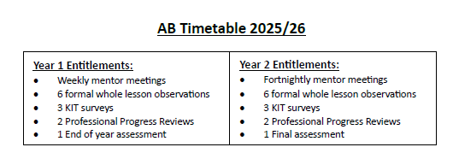
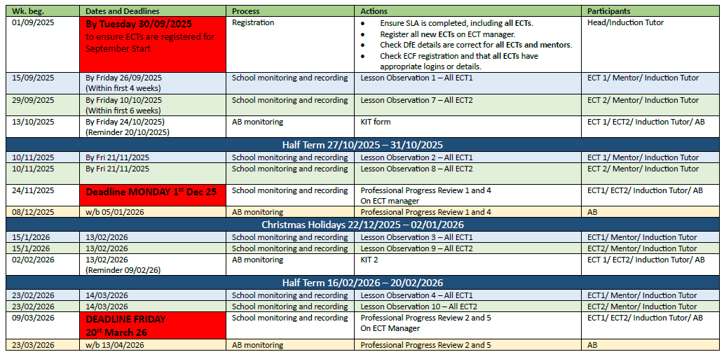

Slide 13
Year 1 of induction
10% ECT release time (in addition to 10% PPA)
Mentor meeting once per week
Lesson observation once a half term (and additional drop ins from mentors)
Induction Tutor progress review every term
Induction Tutor meets with ECT at start to agree targets based on end of ITT targets CEPD (set against the Teachers’ Standards) and to discuss support to be provided in Year 2.
ECT and Mentor continue access Early Career Framework materials and engage with associated training events.
Note:
ECTs are entitled to formal observations and feedback every half term. However, these can be done in a number of ways depending on your school processes.
You may do joint observations with mentor and IT, or Head, Subject Lead etc. It is important that the drop ins should be about supporting progress and development.

Slide 14
Year 2 of induction
5% ECT release time (in addition to 10% PPA)
Mentor meeting once per fortnight
Lesson observation once a half term
Induction Tutor progress review every term
Recommend Induction Tutor meets with ECT at start of Year 2 to agree targets (set against the Teachers’ Standards) for Term 4 and to discuss support to be provided in Year 2.
ECT and Mentor continue to access Early Career Framework
materials and engage with associated training events.
Pay award: A two-year induction will have no adverse impact upon early career teachers’ pay or career progression opportunities. ECTs will still be able to progress on the pay scale as current arrangements allow, both during and after induction.
Additional responsibility in Year Two of induction is acceptable providing there is the appropriate amount of support, the role is suitable for an ECT still completing induction and that the ECT receives adequate time to fulfil the role (protecting their 5% ECT time).

Slide 15
What should a school provide?
“ The programme should support the early career teacher (ECT) and provide them with the necessary training to ensure that they can demonstrate that their performance against the Teacher Standards is satisfactory by the end of the period. Induction should provide a foundation for ECTs and equip with the tools to be an effective and successful teacher.’
DfE Induction for ECTs, March 2021
Good practice:
Induction Meeting - At the beginning Induction Tutor should meet with ECTs and mentors together to set expectations and outline the programme.
Regular check- ins with IT and mentors to ensure everyone knows what they need to do.
Regular check- ins with ECTs to check they are okay.

Slide 16
Pre-Induction Checklist
WHAT to check | WHY check it (to ensure that…)
The headteacher has provided a suitable post for induction. | The ECT has appropriate opportunity to complete induction
The headteacher has verified that the award of QTS has been made. | The ECT meets the requirements to commence induction
The ECT is provided with a named contact (or contacts) within the appropriate body with whom to raise concerns | The ECT has appropriate contacts if they need to raise concerns about their Induction
The Mentor has the ability and sufficient time to carry out their role | The Mentor has sufficient time to facilitate the support they provide ECTs with during induction
The Induction tutor has the ability and sufficient time to carry out their role | The Induction tutor has sufficient time to facilitate the support they provide ECTs with during induction
The school is providing a reduced timetable in addition to PPA | The ECT has sufficient time to engage with the ECF-based induction programme; this is also a statutory requirement
The headteacher has confirmed the type of ECF-based induction they are providing (see Chapter 4 for further detail) | The appropriate body can apply the required level of checks to ensure the ECT has access a high-quality knowledge-based induction
16

Slide 17
Roles and responsibilities
The role of Mentor was formally introduced in addition to the role of Induction Tutor.
The Mentor has a key (arguably the most important and impactful) role in supporting the ECT with the ECF programme and should be separate to the role of the Induction Tutor. They ‘provide, or broker, effective support, including phase or subject specific mentoring and coaching’ (para 5.7).
Larger schools may benefit from an Induction Lead who:
Leads and coordinates induction provision across the school.
Oversees the ECF professional development programme
Co-ordinates the work of Induction Tutors and mentors
The Induction Tutor is responsible for co-ordinating induction and for assessment of the ECT against the Teachers’ Standards, including carrying out progress reviews and report writing.
In exceptional circumstances the Induction Tutor and Mentor role can be carried out by the same person.

Slide 18
Role of Induction Tutor
All ECTs must have a designated Induction Tutor.
The Induction Tutor will be responsible for co- ordinating induction and for assessment of the ECT against the Teachers’ Standards, including carrying out progress reviews and report writing.
This will also include:
Quality Assuring the work of the Mentors monitoring engagement with the ECF of the ECTs and Mentors
Meeting/communicating with/overseeing the Mentors

Slide 19
Induction Tutor role in Induction
Co-ordinate the work of the Mentors: Y1 and Y2 ECTs – do the Mentors have adequate time to meet the ECTs? Is this allocated time protected time for all?
Monitor engagement with the ECF: dialogue between ECT and Mentor. Is this progressing well? How do you know? Impact upon practice?
Meet with the ECTs for a professional review of progress each half Term.
Complete formal lesson observations each half term: verbal and
written feedback provided
Write the termly progress review report / assessment report – do seek information from the Mentors too to inform these reports but they should not be writing the reports
Ensure adequate time for the Induction Tutors to complete their roles / responsibilities each term
This is a big job – be considerate in timetabling! Additional funding has been given for Mentor release time to support the ECT with the ECF. Usually, Mentors are class based and so need release time. There is no funding for IT release time, which is why schools need to ensure they have capacity to support an ECT and to plan in the time for ITs. This is also why a large secondary school needs an IT lead who oversees all ITs so an IT does not have too many ECTs and Mentors to oversee.

Slide 20
The mentor …
The role of Mentor has been formally introduced in addition to the role of Induction Tutor.
All ECTs must have a dedicated Mentor.
The Mentor will have a key role in supporting the ECT with the ECF programme and is separate to the role of the Induction Tutor. They will ‘provide, or broker, effective support, including phase or subject specific mentoring and coaching’.

Slide 21
Mentor role
Year 1 meet with the ECT every week.
Year 2 meet with the ECT once a fortnight.
Engage in the ECF and ensure meetings with the ECT include professional dialogue linked to the ECF as part of the meeting.
Report to the Induction Tutor / Leader in school regarding the ECT’s progress / strengths / areas for development / targets.
The mentor role is consistently stated as the most important relationship for ECTs

Slide 22
ITTECF based induction
Schools are expected to deliver an induction period that is underpinned by the ITTECF, a programme of professional development for ECTs and mentors (see para 2.39).
Developed by a group of education experts and independently reviewed by the EEF to ensure it is evidence-based
‘Learn that’ and ‘learn how to’ statements for each theme
5 themed areas linked to the Teachers’ Standards
The DfE have commissioned national organisations to develop training materials that meet the learning areas stated in the ITTECF
Lead providers will work with/train local facilitators (e.g. Teaching School Hubs) to deliver the training
Parallel training for mentors to understand the ITTECF, associated research and develop their mentoring and coaching skills.

Slide 23
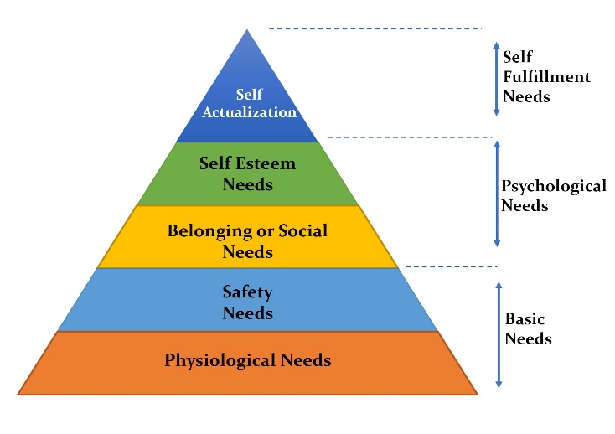
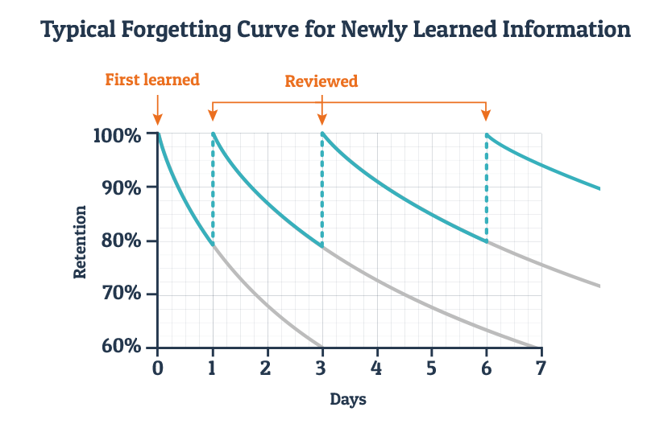
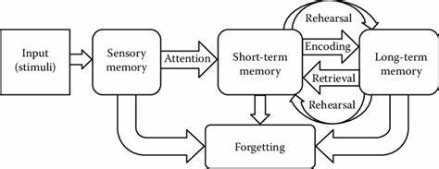
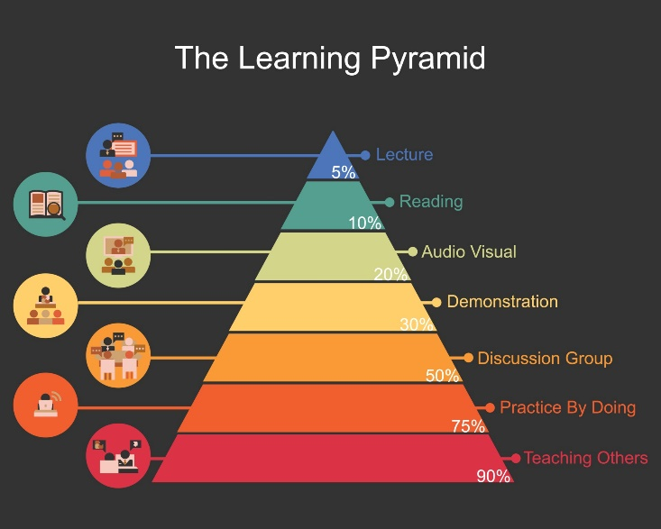
Why is it so important?
There is such a lot to know!

Slide 24
The Five Core Areas of the ECF
The ECF has been designed to support Early Career Teacher development in five core areas. These relate to the Teachers’ Standards but are not exactly the same.
Behaviour Management
High Expectations (S1) Managing Behaviour (S7)
Pedagogy
How Pupils Learn (S2) Classroom Practice (S4) Adaptive Teaching (S5)
Curriculum
Curriculum (S3)
Assessment
Assessment (S6)
Professional Behaviours
Professional Behaviours (S8)
The ECF should not be used as an assessment
framework, and assessment should only be made against the Teachers’ Standards.

Slide 25
The ECF is a curriculum, and just like the curriculums that you will design and deliver through your teaching career there is a reason it has been created like it has.
The ITTECF training framework has been created to provide coherence for training. The same evidence underpins both ITT and ECT training.
It enables teachers to revisit key ideas with increasing depth, in real teaching contexts, and through different lenses

Slide 26
ITT ECT1 ECT2
Embed and adapt strategies to meet individual needs
Sustain strategies and consider the wider school culture
Select appropriate strategies
Mentors should be thinking ahead and together with the ECT prepare for seminars.

Slide 27
Providing an ITTECF based professional development programme:
Provider Led: A DfE funded provider led programme via a delivery partner (e.g. Cambridgeshire and Peterborough Teaching School Hub using Teach First Materials).
School Led: Schools deliver their own training using DfE-accredited materials and resources or deliver their own ITTECF based professional development programme.
Note: If schools choose option 2, the Appropriate Body will need to fidelity-check your programme before induction starts as well as during the induction period itself, which will incur additional costs.

Slide 28
Funding
Funding
Year 1 funding
Schools should use their core funding from the DSG to fund the ECTs first year of their entitlement. Core funding is not ‘earmarked’ for ECTE, but headteachers should use it to cover the cost of ECTs 10% time off timetable .
Year 2 funding
Year 2 funding is covered by grant funding. Schools will get a one payment at the end of the ECT’s second academic year. Year 2 grant funding covers the cost of each ECT’s:
5% time off timetable
20 hours of mentor support
This is calculated using the average hourly rate for mentors and ECTs, split by region.
Mentor training funding for September 2025 onwards
Grant funding for mentor training is available to schools and establishments that use DfE funded training providers to deliver training as part of the ECTE.
Mentors will be given up to 20 hours to carry out mentor training for one year. Schools will be funded to support the mentor to undertake the training.
This funding will be paid in arrears at the end of each academic year. Payments will be based on evidence that the mentor participated in the training, as confirmed by the lead provider.
Mentors can only do this training once. They can continue their training even if their ECT transfers school or withdraws part way through their ECTE.

Slide 29
Funding differences for the 3 options
Year 1 of induction will continue to be funded through the school funding formula.
 | Funding for ECT release time in year | Funding for mentor release time in year 2 | Funding for mentor training time (20 hours over 1 year) | Fully funded training programme for ECTs and mentors
Provider led programme | ✓ | ✓ | ✓ | ✓
School led programme | ✓ | ✓ | x | x
Note: Non-state funded settings will not be able to access the provider led programme for free. It is likely that non-state funded settings will only be able to opt for the school led programme.
(CPTSH Lead provider offer a programme, contact to discuss if this will work for you)

Slide 30
Option 2: School Led
Schools/trusts will need to choose one of the two provider programmes available here:
National Institute of Teaching (NIoT)
Materials for school-led ECT Programme 2025/26 – The National Institute of Teaching
University College London (UCL)
CEL - The Source - ECT
Each provider has a suggested programme and resources available to help you deliver your own training for ECTs and mentors.
The school/trust will need to design a programme based on those resources and submit an initial fidelity checking form to the AB before induction starts.
The AB will check that your plans align with the programme of the provider you have selected. Any differences need to be clearly rationalised and then follow up with additional fidelity checks (with a focus on the implementation of the programme) in year 1 and year 2.

Slide 31
Assessment of ECTs
ECTs cannot fail their ECF-based training.
ECF-based training is a professional development programme. It is designed to help your ECT develop their teaching knowledge, skills and working habits. ECTs should participate in their ECF- based training as fully as possible, but failing to complete it will not mean they fail their induction.
ECF-based training is separate from the formal assessment of an ECT’s performance against the teachers’ standards. How the early career framework (ECF) supports induction - GOV.UK (www.gov.uk)
Funding and eligibility for ECF-based training - GOV.UK (www.gov.uk)
The MENTOR is integral in facilitating this for context and stage of the ECT. It is not just repeating information but reinforcing and consolidating learning.

Slide 32
Assessment
There are two formal assessment points, requiring assessment reports: one midway through induction (the end of Year 1, Term 3) and one at the end of induction (the end of Year 2, Term 6).
The assessment points are supported by regular progress reviews to monitor progress, taking place at the end of each term where there is no formal assessment (Terms 1, 2, 4 and 5).

Slide 33
Teacher Standards
Effective since 1st September 2012 …
Part One – Teaching
Part Two – Personal and Professional Conduct
It defines the minimum level of practice expected from teachers from the point of being awarded QTS.

Slide 34
Part-time ECTs
In cases where ECTs working part-time can demonstrate that they have met the Teachers’ Standards consistently, the AB is able to reduce the length of the induction period and bring forward the final assessment point.
This decision must be made in agreement with the ECT and once the ECT has completed a period covering at least, but not equivalent to, two school years (i.e. 6 terms).

Slide 35
Overseas Trained Teachers
Teachers who trained abroad and have been granted QTS under the new processes for overseas trained teachers will need to complete a 2-year induction if they haven’t taught for at least 2 years.
This can be confirmed with the TRA.

Slide 36
Absence
The induction period is automatically extended prior to completion when an ECT’s absences per year of induction (or equivalent for part-time teachers) total 30 days or more (with the exception of statutory maternity leave, statutory paternity leave, shared parental leave, statutory adoption leave, parental bereavement leave or carer’s leave.
In these circumstances the induction period must be extended by the aggregate total of days absent. If the ECT is unable to serve the extension in the same school/institution, the minimum period of employment of one term or equivalent must be served in a new school/institution.

Slide 37
What to consider beyond the ECF
Targets from end of ITT
Whole school priorities – SDP and CPD (Does any of the ECF support these school priorities?)
Year group / subject / phase being taught
Specialist CPD such as for phonics, Y2 / Y6 assessments, GCSEs, A Levels
Use of release time … DO NOT USE FOR ADDITIONAL PPA!!
Used for activities other than planning, preparation and assessment.
Help the ECT to meet the teacher standards and meet their targets
Linked to the ECF
Record how you use your 10% release time – date / time / activity / teacher standard improved as a reflection activity
Effective use could include:
Visiting another setting – highly recommended!
Observing other teachers in school
Meeting ESL, MSL, SENCo, Head of Department
Preparation for Parent Consultations
CPD / network meetings

Slide 38
Other considerations
Allow your ECT to be supported / shadowed at Parent Consultation meetings
Ensure experienced staff support ECTs to plan and lead educational visits – ECTs should not normally be leading such trips
Ensure you value and listen to your ECT’s ideas – they will be
really enthusiastic!
Consider the well-being of your ECT – there will be times when they will need a shoulder to cry on
Remember they do not know what they do not know!

Slide 39
Evidence for Assessments
Drawn from the ECT’s work as a teacher during their induction.
Formal assessment meetings informed by evidence gathered during progress reviews and assessment periods leading up to the formal assessment.
This will consist of existing documents and working documents.
No need for the ECT to create anything new for the formal assessment, they should draw from their work as a teacher and from their induction programme.
Judgements made during the induction period should relate directly to the Teachers’ Standards and should not be made against the ECF.
ECTs should be kept up to date on their progress. There should be nothing unexpected.
Lesson plans, marking, lesson observation feedback.
Minutes of meetings with induction Tutor/Mentor
Assessment reports
ECF Learning
Feedback from Parent Consultations
There is no set expectation: Each school will have their own expectations but be mindful of workload for all parties!

Slide 40
Termly Cycle of Support
Term 1
Check QTS and register with AB – It is vital that the TRN and DoB are correct or the ECT will not be authorised.
Initial meeting within first 2 weeks – identify training needs / set targets, outline Teacher Standards.
Observation and follow up discussion / written feedback of lesson
1st review meeting
Half Term
2nd observation
Follow up discussion / written feedback of lesson observation
2nd review (or pre-assessment) meeting
1st progress review meeting. End of term form to AB
Initial meeting:
Induction Tutor, Mentor and ECT within first 2 weeks of induction
period
Half termly meeting:
Induction Tutor and ECT throughout the induction period
Review meeting:
6 meetings between Induction Tutor and ECT at the end of each term.
Other meetings according to need for example; if the progress of the ECT against the Teacher Standards is a cause for concern
Half termly meeting:
Timetabled
Opportunity to assess against Teacher Standards
Written record kept (progress against standards, reviewed / new targets, use of release time, Early Professional Development sessions)
ECT weekly development log

Slide 41
Progress Reviews and Assessment Points
The assessment points are supported by regular progress reviews to monitor progress, taking place at the end of each term where there is no formal assessment (Terms 1, 2, 4 and 5). These will be submitted to the AB.
These are succinct reviews:
On track / not on track at that point
Brief reasons as to how this is known / evidence
ECT must comment
Two assessment points during induction which are submitted to the Appropriate Body (AB) are at the end of Year 1 (term 3) and the end of Year 2 (term 6).
These will be detailed to include:
Feedback from lesson observations and previous reviews
Review of evidence of progress towards the Teacher Standards
Preparation for the relevant assessment form to be completed
Agreement on the focus for future objectives and further evidence or progress

Slide 42
Writing an effective assessment report
Must cover ALL the Teaching Standards: Part One and Part Two
Explicitly state the strengths and the areas for development – name the teacher standards
List the targets for the next term
Cite the evidence base: Mentor input too.

Slide 43
Cause for Concern…
ECT Induction Tutors should have strong recorded evidence that the ECT is a cause for concern (lesson obs, weekly meetings, other meetings, failure to attend the school’s own professional development meetings).
Positive and open working towards areas of identified weakness
The sooner problems are raised, the better
Action to improve should not be delayed until a formal assessment meeting
Induction Tutor inform Head immediately
Contact The Appropriate Body
as soon as any concerns are apparent. DO NOT LEAVE UNTIL SUBMITTING AN ASSESSMENT REPORT!!!
There should be no surprises for anyone at the end of each term!

Slide 44
Extending Induction
Extensions can ONLY be approved and awarded by the Appropriate Body working with the school – a school cannot inform the ECT / AB of an extension!
An ECT has the right to seek representation from their Professional Association and has the right to appeal the decision.

Slide 45
End of Induction
Review professional development during entire induction period – how much achieved!
Celebrate successes, reflect upon challenges and progress during the year
Evaluate the induction period
Identify objectives for the third year – performance management cycle
The final decision on the satisfactory completion of induction is made by the statutory Appropriate Body, based on the school's recommendation.
Please remind your ECT to log on to the TRA website and download their induction certificate.
These are no longer issued and do need to be kept as evidence that induction has been successfully completed.

Slide 46
Key actions
Allocate key roles of Induction Tutor and Mentor for all ECTs.
Ensure Mentors have adequate timetabled release time to fulfill their role:
Time to become familiar with the Early Career Framework professional development programme and associated resources, attend training and work with the ECT. We suggest that the mentor will need at least 1 hour of protected time per week to meet with the ECT in year 1 and one hour per fortnight in year 2.
Ensure Induction Tutors have adequate timetabled release time to fulfill their role:
Time to meet with the ECT at the start of induction to discuss their initial targets from their teacher training and discuss a relevant action plan. We suggest good practice would be to have half termly meetings to discuss progress against the Teachers’ Standards. They will also need time to carry out observations and feedback (suggested once per half term).
Download the Induction Handbook (resources section of ECT Manager) and distribute to all involved in induction.
Ensure an ECT Induction Policy is in place and available on your school or Trust website (see example in resources
section of ECT Manager)
Ensure the ECT is registered with the AB
Ensure your ECT is registered for the ECF via the DfE portal and with the correct provider
Complete this form https://forms.office.com/e/GW9GhMC1xi

Slide 47
Important …
The newsletter is sent every week:
Thursday 9am
This gives an update of the key things that are happening each week, including deadlines, and booking training. Please take a moment to read this each week, to keep yourselves updated.
If you don’t receive it, let us know and we will add you to the mailing list

Slide 48
Learning from QA visits
It is more than just the entitlements though. It is the culture of the school that invests in professional development and utilises the ECF programme to upskill all staff and utilise ECTs to drive some of this training.
Seeing the value in the ECTE and not just ticking a box to get through it
Some smaller primaries utilising Trust support capacity.
ECTs need to meet the Teachers’ Standards, but keep expectations measured … They don’t know how to do everything, if new to the school they won’t know people, places, policies so support them with that. Outline the calendar, explain how to prioritise. Cognitive overload happens in adults as well as children!
If you have been at a school for a long time and not changed schools, ask new staff to tell you the biggest challenges they have faced and work out how to support that as well as talking to the ECTs.
ECTs that feel valued and supported and feel able to make mistakes and make progress want to stay in the profession.

Slide 49
Changes … Reduction requests
We firmly believe that the induction process is a vital piece of positive framework which is in place to support and empower teachers to develop, grow and refine their teaching practice and pedagogy. Every ECT has the right to support, training and mentoring for two full years and we encourage all ECTs to take this opportunity.
Before applying for a reduction, we ask that the reasons are reflected upon as to why the ECT might not feel the need to make use of the full 2-year support period and how this might affect their continued professional development & mentor support.
However, in some situations, it may be the right course of action:
ECT will meet with the AB team to discuss the reasons for applying for reduction.
ECT will complete an online form to request reduction
AB will send the reduction policy to IT/Head to complete
There are three reasons that an ECT could reduce:
Part-time – can be requested in term 5
Previous experience – ECT has to have at least 2 years of unqualified teaching experience (in a teaching role not HLTA/TA) that does not include training
Administrative Error

Slide 50
Changes … Maternity leave
Before they go on maternity leave the ECT will be sent an email with information so that they can prepare. They will not make any decisions at this point.
On return, the ECT will receive further communication outlining their options. However, they will not make any decisions until the next assessment point. This gives the school time to ensure that they are able to meet the Teachers’ Standards.
The ECT will complete an online form to confirm their options
Their induction will be amended on ECT manager as necessary
Everyone is different, but returning after extended absence can be difficult, so having a dedicated mentor and access to the entitlements can really help the return.
The ECTE is not something to get through or box tick, but actually to support teachers to be competent and confident in their job which benefits retention!

Slide 51
Changes … Exit interviews
As is always required, there will still be a leaver Form for the school to complete. However, we will also contact the ECT to ask them to complete an Exit interview for us.
This supports our intelligence gathering on movement in, around and out of the profession with some qualitative feedback.
This information will not be passed back to the school.

Slide 52
For those that will be with the TSH for ECTP (Teach First) you will soon receive a form to complete/send on to your ECTs for the Welcome conferences. It will be a Microsoft Form.
We want to ensure that all ECTs are able to attend the ECTP conferences so to avoid missing any ECTs, we are asking Induction Tutors to help.

Slide 53
Key Contacts
Helen Thatcher
AB Lead
hthatcher@cptshn.co.uk
01223 491639
Emma Barnes
AB administrator
EBarnes@cptshn.co.uk
01223 491674
Julie McBrearty
ECT Project Manager
ECF Queries:
SCrowley@cptshn.co.uk
Shannon Crowley
Senior Administrator
ECF Queries:
SCrowley@cptshn.co.uk
Additional:
Named contact:
CentralHR@meridiantrust.co.uk
Appropriate Body inbox:
AB@cptshn.co.uk

Slide 54
ANY QUESTIONS?

