Slide 1
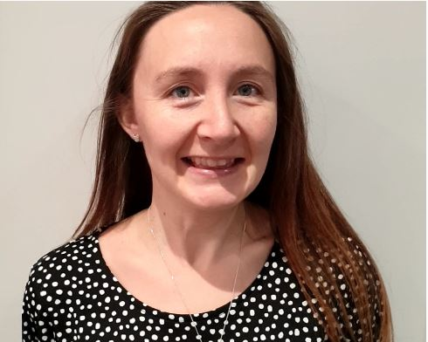
ECTE Registration Process Guide
How to register Transferring and New Yr1 and Yr2 ECTs for Academic Year 2025/2026
Created by Emma Barnes (Appropriate Body Administrator)
Ebarnes@cptshn.co.uk
01223 491674

Slide 2
Contents of the Guide
This guide is designed to support Induction Tutors and Headteachers in schools planning to register Early Career Teachers (ECTs) with the CPTSH Appropriate Body for the 2025/26 academic year. It outlines how to register new ECTs or those transferring internally or externally, using clear, step-by-step instructions for each system involved in the ECTE (Early Career Teacher Entitlement) programme. If you have any questions or concerns while using this guide, please refer to the contact details on the front page.
This guide will cover:
A step-by-step walkthrough of the registration process for each platform used during ECTE induction.
Guidance to simplify the registration experience across the main systems.
A feedback form at the end for any suggestions or comments on this guide. Please note: While we welcome feedback on the guide itself and its use, the systems used for registering an ECT are not owned by CPTSH, and we are unable to make changes to their processes although we may be able to assist with raising feedback to the relevant companies/suppliers.

Slide 3
Registration Steps
To ensure a smooth registration, please complete the steps in the order listed below where possible. However, if you've already started a step, you may continue out of order.
Service Level Agreement (SLA) - Must be completed by all schools, whether continuing with or newly joining the Appropriate Body (AB). Only include new or transferring ECTs registering for 2025/26. Do not include ECTs already registered and continuing at the same school.
ECT Manager Registration - Required for new ECTs or those transferring internally or externally into or within the AB. If an ECT is already registered and staying at the same school, their registration will roll over automatically.
Both the SLA and ECT Manager registration must be completed by 30th September 2025 for ECTs to be included in the September 2025/26 cohort. These steps are part of the statutory registration with the Appropriate Body and can begin from 7th July 2025.
DfE Portal Registration & ECTP Access - DfE invites have been sent to schools the week of 30th June. Follow the instructions in the email or this guide. If you have not received an invite, please contact the AB. Your school may need to be claimed. Each school is allowed only one nominated user - ensure your school is aware of who holds this responsibility:
If using the Provider-Led route with CPTSH’s lead provider Teach First: Once registered on the DfE portal and your school has been claimed, ECT and mentor details will be automatically transferred to Teach First’s portal, BrightSpace. This process can take up to 10 working days from the DfE registration.
If using another lead provider or the School-Led route: The school is responsible for choosing and contacting the appropriate provider or accessing school-led materials directly via the provider’s website.

Slide 4
Step 1 – Completing the CPTSHN Service Level Agreement

Slide 5
As mentioned, the Service Level Agreement or SLA is step 1 in completing registration for statutory ECTE induction. It makes up the contract between the school and the AB. It is important that the contents are read through carefully, as ECT Manager asks you to confirm that you are happy with the terms & conditions within when you first go to register and you cannot proceed until this is complete.
The AB will also not be able to authorise an ECT’s induction until the SLA has been completed, signed and returned so it is important that it is the 1st step that is completed in registration where able.
The link to the service level agreement (SLA) form can be found here - Cambridgeshire & Peterborough Teaching School Hub - AB Service Level Agreement. There is also a link to it on the registration steps.
SLAs are to be completed by all schools at the beginning of a new academic year (existing or brand new) as the conditions within are subject to change. At the January and April registration points if a school have already completed an SLA, they will not be required to complete this again, instead we will ask that the following addendum to the service level agreement form is signed and returned. Please email the AB if this relates to you and you have any questions regarding it when it comes to January or April registration.
If you are ever unsure which one of these two forms needs completing, then please do not hesitate to reach out and ask.

Slide 6
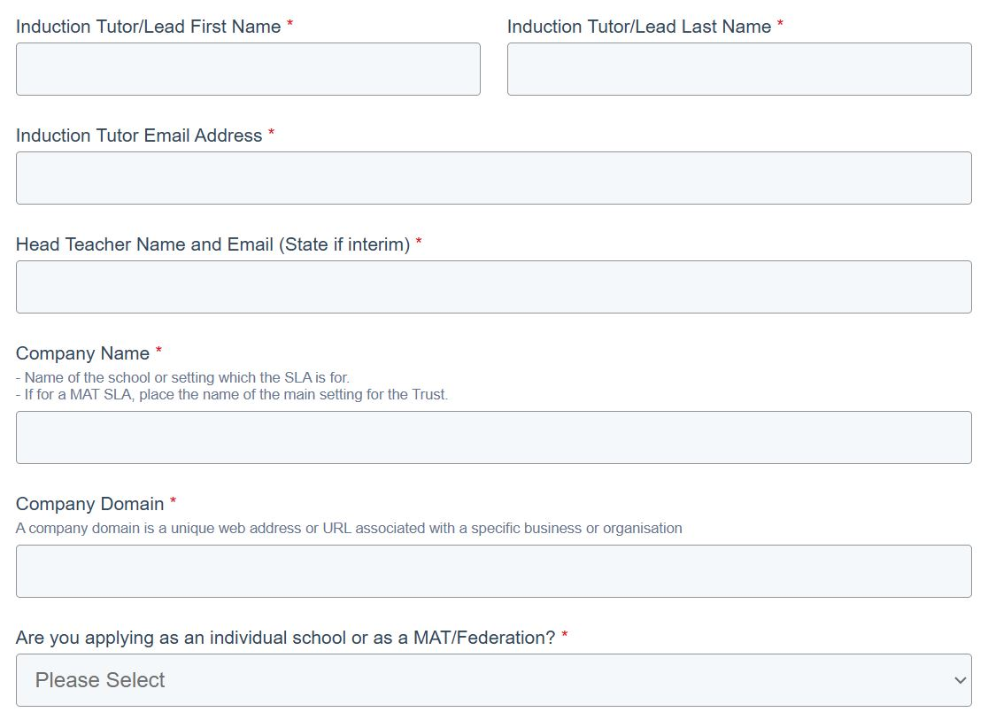
Please tick the confirmation box before proceeding otherwise the SLA will not be able to be submitted.
Please ensure when filling in the Tutor and Headteacher details that the most up to date person is included in both roles and with the Headteacher role state whether the person will be an Interim Head or not.
If the current Tutor is moving on in September, the AB would advise that it may be best for the new IT to complete the form where possible. This will ensure records are kept as up to date for the school.
The company name and company domain refer to the name of the school in which the SLA is for, when completing one at MAT level, please just list the names of all schools within the MAT. This is so the SLA covers those schools for January and April registration. Company domain refers to the web address or URL which relates to the school's website.
It is possible for schools to register on a MAT level, although the AB would advise that where possible individual SLAs are completed. If a school chooses to complete at MAT level, as mentioned all schools within the MAT under the ABs responsibility will need to be stated and when listing ECTs and mentors, please separate under headings which ECTs/Mentors will be at which schools etc.

Slide 7
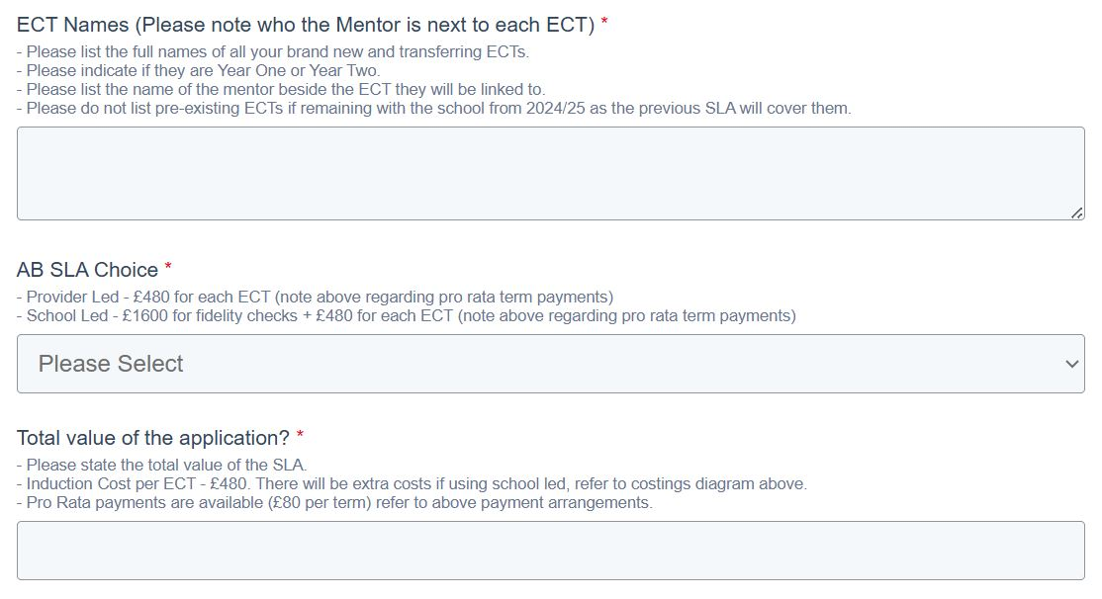
ECTs should be noted by the name they will be known as on the DfE and ECT Manager registration so cross checks can take place.
Please list the ECT name clearly, followed by which year of induction they are and then list the mentor if known. This only needs to be completed for any new or transferring ECTs to the school. Please do not include existing as the previous 24/25 SLA will cover these.
AB SLA Choice refers to the route the ECTs will be taking for induction, the options for this have changed for the new academic year and this is either Provider Led or School Led now. If you are unsure, please do reach out and the AB will be able to advise however, provider led is the new name for the previous DfE funded route and school led refers to the new name for the mix of the previous accredited materials & design your own routes.
The charge for ECTs has remained the same for the 2025/2026 academic year. If using the provider led route, funding from the DfE will be provided to cover the ECTP (old ECF training) however, the cost of the ECTs induction will need to be covered by the school, for the 2-year programme this is charged at £480 per ECT. This is for brand new ECTs and transferring ECTs as any existing ECTs who are remaining in their previous school will have already had a charge raised against them in 2024/2025.
If using the school led route, schools will be required to pay a one-off payment of £1600 to cover fidelity checks/visits made by the AB within the 1st year of induction. £480 will then be charged per ECT as above to cover induction costs. There will then be a fidelity check top up payment worth £400 to cover the AB Leads visits/checks for any following years onboarding.

Slide 8
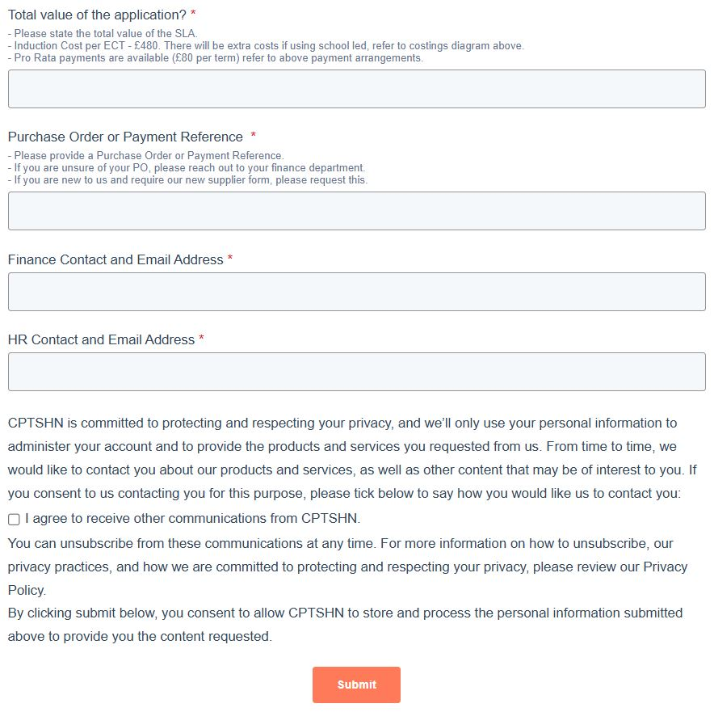
The schools finance team should be able to provide the relevant purchase order or reference, please reach out to yours to obtain this. The SLA can be submitted with a temporary one, but the actual PO will need to be sent across as soon as obtained if choosing to do this as the AB require this for invoicing purposes.
Please try and input the most relevant contact within these sections, the same person can frequent both if needed. These will aid the AB with invoicing as it will provide them with a direct contact to reach out to regarding invoices/remittances and so on.
Once completed and submitted, this marks the end of the form, and this will pass to the AB to review and use to authorise any ECTs who are mentioned and registered. Movement onto step 2 and registering on ECT Manager can now begin.

Slide 9
Step 2 – Completing ECT Manager Registration

Slide 10
The first part of registering on ECT Manager is ensuring the School, Headteacher and Induction Tutor are registered on the system. If unsure of how to do this, please refer to the below guides or reach out to the AB and they will be able to complete this on behalf of the school if required.
If the user exists already in the system, they will be able to log in and add their school if needed, follow the Adding a New School guide below. If the school and user are all completely new to ECT Manager, then refer to the Register your school at this Appropriate Body guide. If the school has been registered previously but no users exist or you need to add a new user, then follow the Create new school user guide to add and request these:
Register your school at this Appropriate Body | ECT Manager Help Center
Adding a new school | ECT Manager Help Center
Create new school user | ECT Manager Help Center

Slide 11
The following slides will guide you through how to register a ECT for the 2025/2026 academic year,
When you go to register an ECT on ECT Manager, the system will use their TRN to complete a full search of the system to see if that ECT already exists. Below is a list of short tutorials which will take you through each registration type, if after watching these you have any questions then please do book a meeting with myself – https://meetings-eu1.hubspot.com/ebarnes1 or give me a call - 01223 491674.
New ECT starting their induction in Term 1 (TRN not found in search) - https://youtu.be/dcQzJW8m3Xg (Register the ECT from scratch) – this will be covered in this guide.
ECT has worked at a different school at a different Appropriate Body - https://youtu.be/zWakm4BcAuU (Register the ECT from scratch) – although like the above, the key difference is the user will be asked to input the ECTs previous school information alongside the other information needed, if you need help with this aspect please refer to the video tutorial.
ECT is found at this Appropriate Body but at a different school (ECT is moving schools within the Appropriate Body) - https://youtu.be/0YJKAnKH2sg (Transfer the ECT to the different school within the Appropriate Body) – please refer to the video tutorial.
ECT is found at a school with the same postcode but at a different Appropriate body - https://youtu.be/AGeLWK3kS1I (Transfer the ECT and school to this Appropriate Body) – please refer to the video tutorial.
ECT is found at your school but at a different Appropriate Body - https://youtu.be/FXt4H6OzM4Q (Transfer the ECT to this Appropriate Body) – please refer to the video tutorial.
ECT is found at this Appropriate Body and at your school (ECT is returning to the same school) - https://youtu.be/fWSe1Q2dXVA (Register the ECT again) – please refer to the video tutorial.
TRN indicates that the ECT has already completed induction - https://youtu.be/4BjkJNVL0Zc (Double check the ECTs details with the AB and if confirmed as completed then there is no need to register) – please refer to the video tutorial.

Slide 12
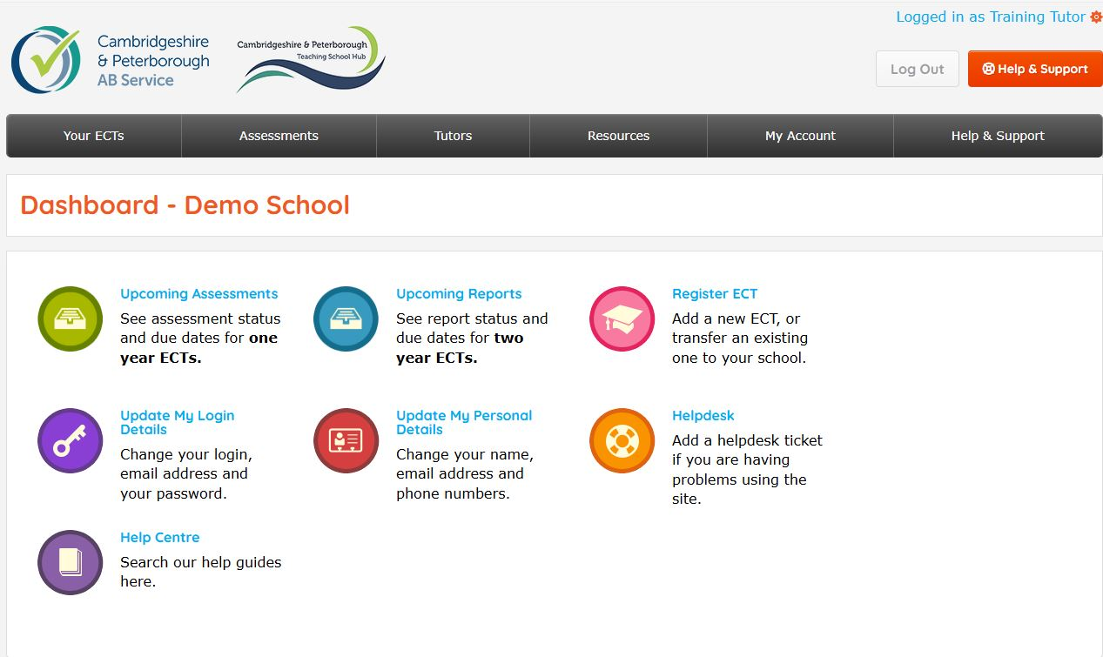
Once logged into the dashboard, the user can either navigate to the top menu and hover over ‘Your ECTs’ then select ‘Register ECT’ or there is an option on the main dashboard screen to ‘Register ECT’.

Slide 13
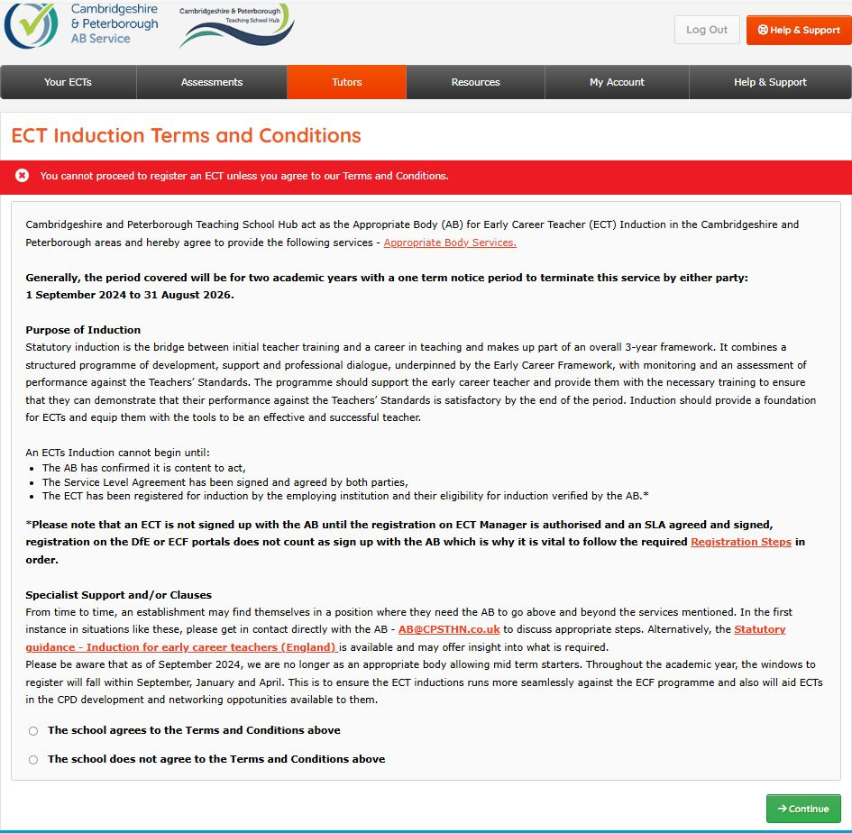
Once clicked, the first window to pop up will be terms and conditions of registering an ECT, these must be agreed to for the user to proceed.

Slide 14
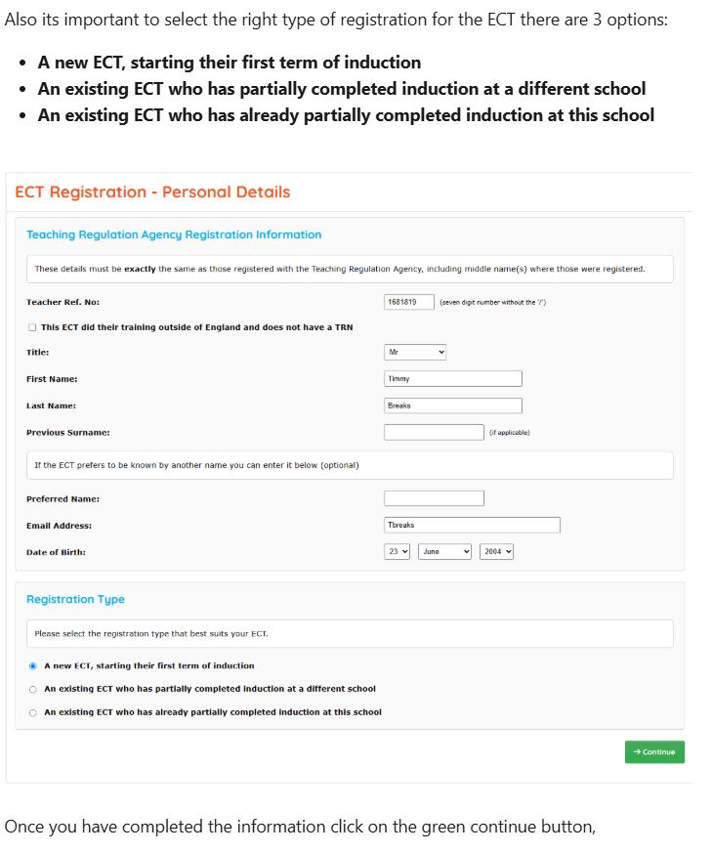
The next window will relate to the ECTs personal details, please ensure that the ECTs TRN & DOB are inputted correctly as this can cause issues with verifying their QTS with the TRA and can cause holds ups with authorising the ECT. It is important to ensure you select the right type of registration, see below:
A new ECT, starting their first term of induction
An existing ECT who has partially completed induction at a different school
An existing ECT who has already partially completed induction at this school
If the ECT falls into either the 2nd or 3rd category of registration then refer to previous types of registration slide for more information and tutorials.

Slide 15
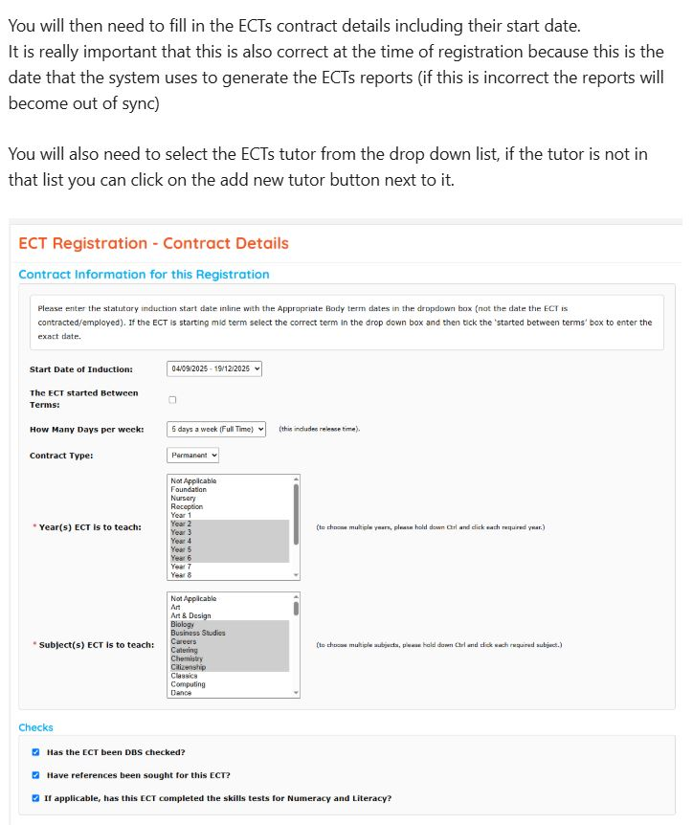
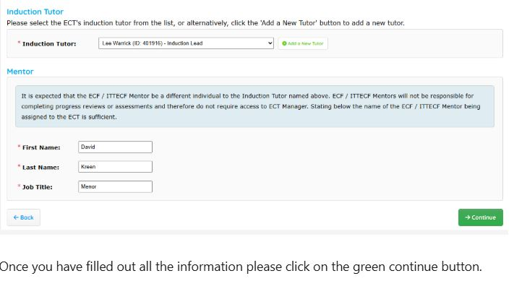
Next the system will ask for the ECTs contract details, please read the text to the right for things to be aware of when inputting this information.
The start date is not the start date for when an ECT began at the school, it is rather the start date of onboarding with the AB, for September this should be the 01/09/2025.

Slide 16
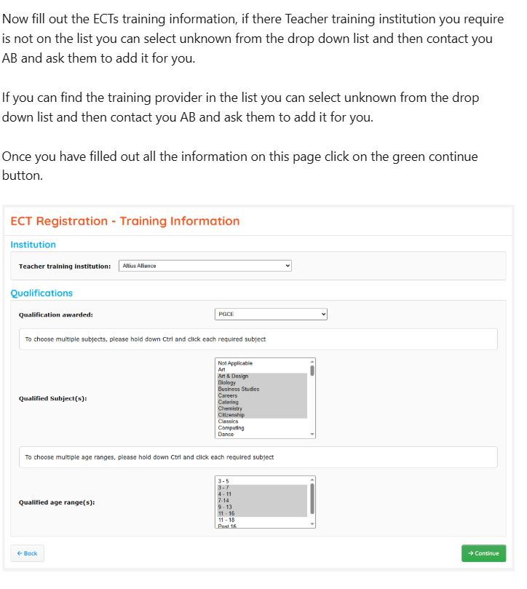
Next the system will ask for the ECTs ITT training details, if the relevant institution or qualification is not present, please reach out to the AB and they can add this for you.

Slide 17
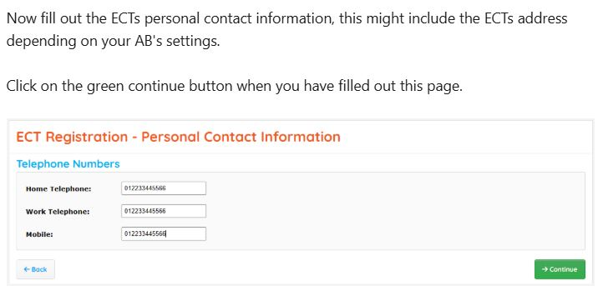
Next the system will ask the user to input the ECTs contact details including their address and at least one means of communication i.e., phone number (home, work or mobile).

Slide 18
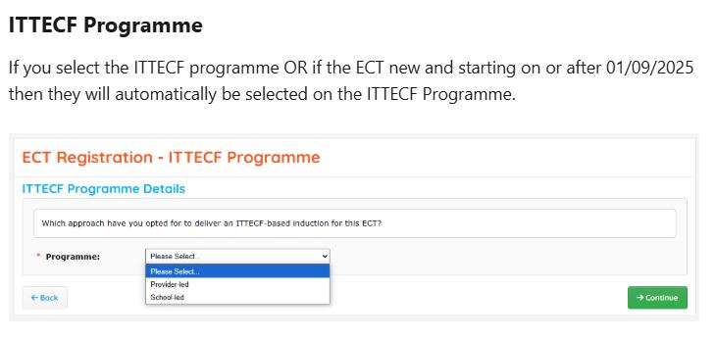
ECF/ITTECF Programme Choices
You will mostly need to select this option if you have a transferring ECT, follow slides 19 & 20 for details of the 3 routes available within the previous ECF programme.
As mentioned, you will need to use this programme for any new or if you choose to move any existing ECTs to this route, for details of the routes, see slide 21.

Slide 19
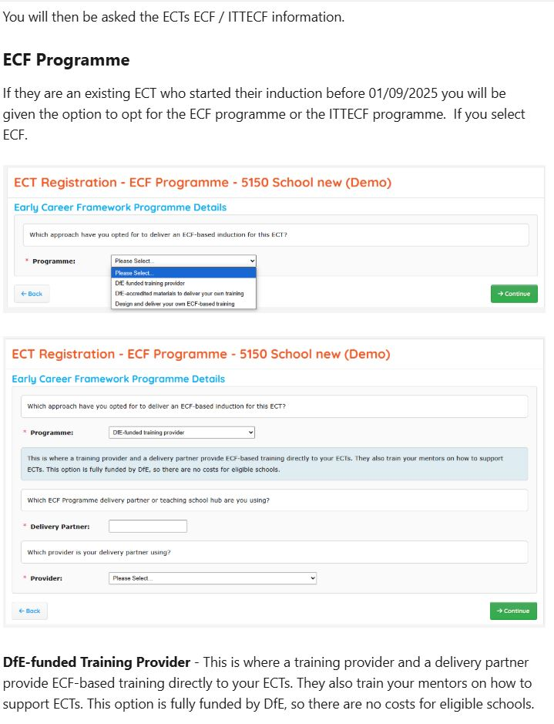
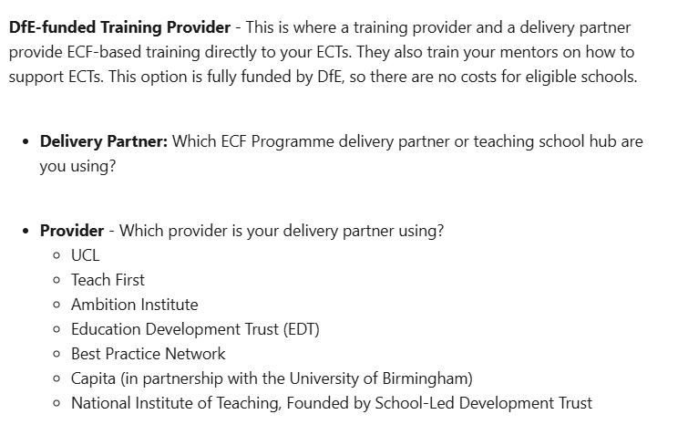
ECF Programme – DfE Funded

Slide 20
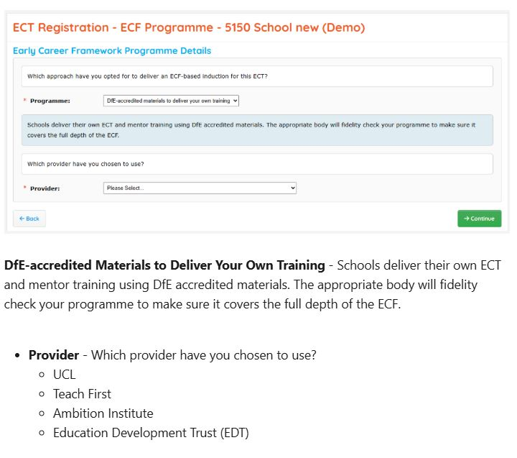
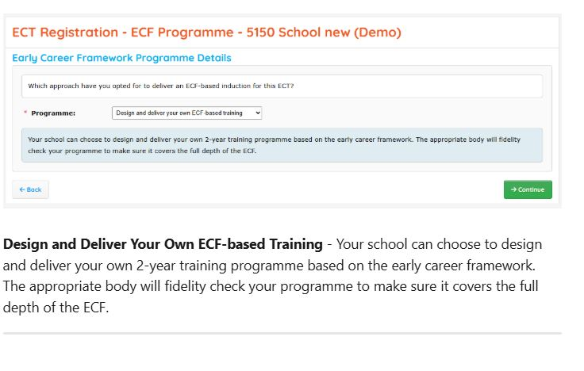
ECF Programme – DfE Accredited
ECF Programme – Design and Deliver

Slide 21
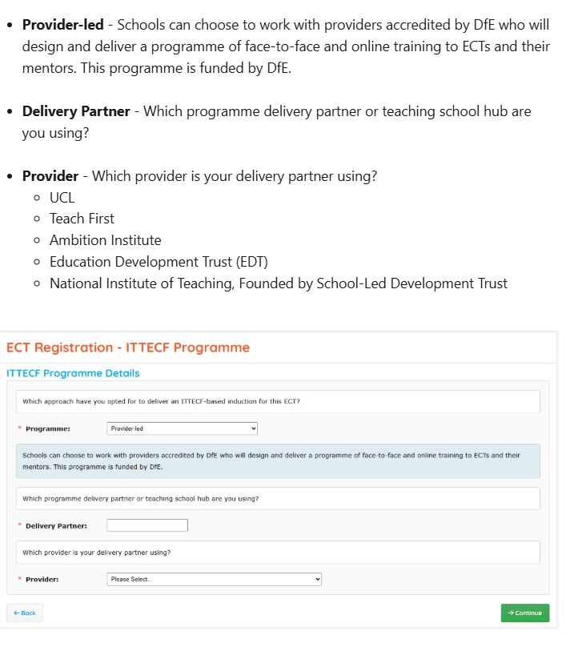
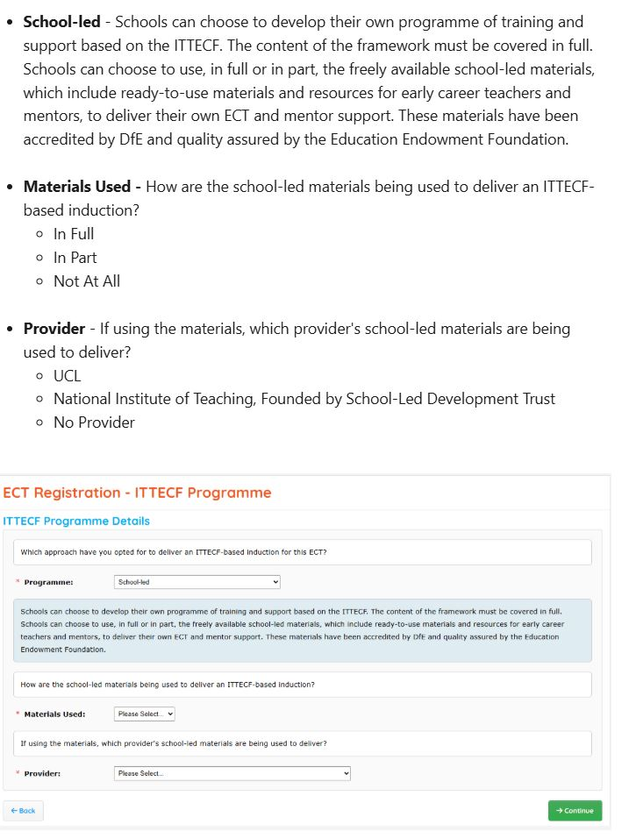
ITTECF Programme – Provider Led
ITTECF Programme – School Led

Slide 22
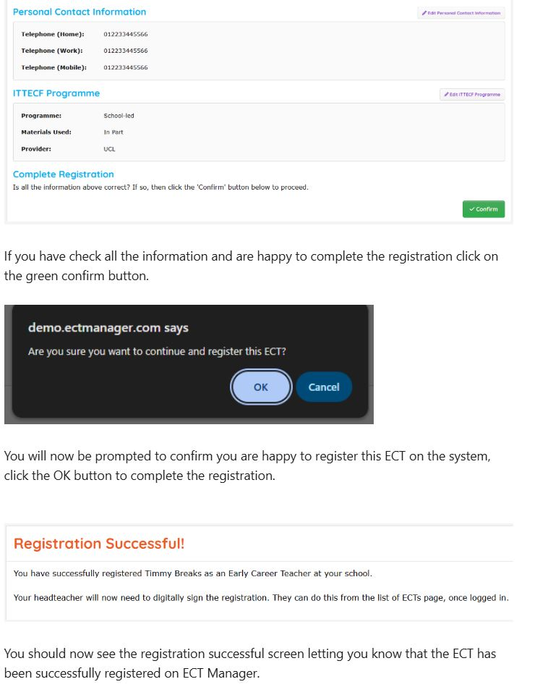
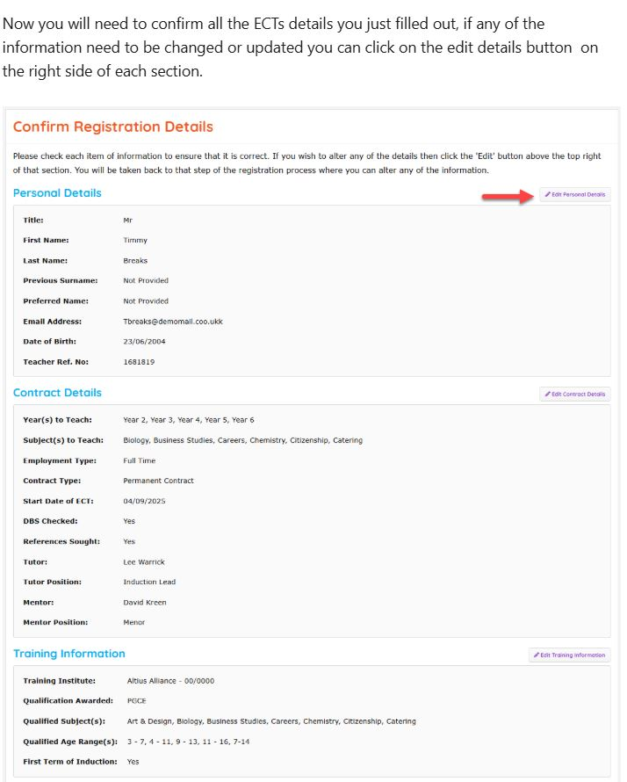
Confirmation of Details

Slide 23
Step 3 – Registering on the manage early career teachers DfE portal & ECTP Access

Slide 24
Link to portal - https://manage-training-for-early-career-teachers.education.gov.uk/
School nominates their induction tutor or logs in
Induction tutor selects the school’s delivery route for 2025
Providers confirm school’s delivery partner
Induction tutor registers ECTs and mentors
Information available to Providers
All maintained schools invited by email to nominate the person responsible for organising induction in their school. If the school did this last year, the tutor can simply log in.
Choose between the 2 delivery routes or let us know they do not expect to receive ECTs next year. If their provider relationship can be carried over from last year, this option is presented.
ECTs and mentors can be registered to the service. The service locates their central DfE record and assesses eligibility for training and funding. The service will automatically recognise the cohort and whether the participant is transferring or not.
If a partnership has not been carried over from the previous year by the school, the Provider must report the partnership with the school. Schools receive an email notification of the partnership and can reject a partnership if they don’t recognise it.
Information is made available to lead providers via the API. Lead providers are responsible for passing information on to their delivery partners and setting up access to training.
1
2
3
4
5
Steps 3 and 4 can happen independently of each other and in either order.
However, both steps must happen for Step 5 to occur.

Slide 25
Programme selection for the 2025/26 academic year
How to nominate an Induction Tutor

Slide 26
Register an ECT starting training from AY2025/26
Register a mentor starting training from AY2025/26

Slide 27
ECT Transferring from another school
Assign a mentor to an ECT

Slide 28
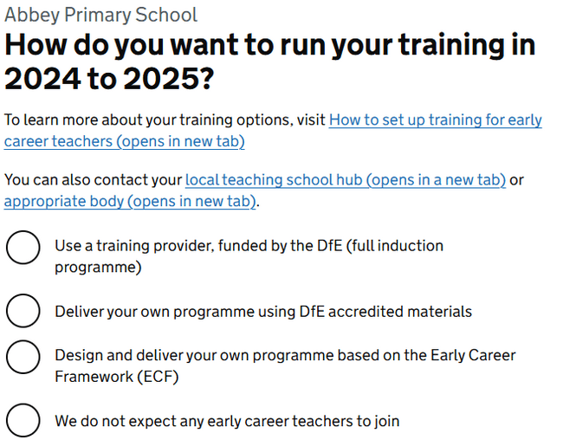
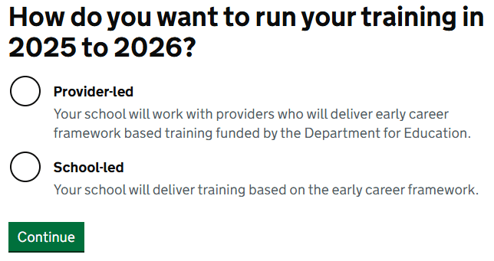
Amend an ECT or mentor information
Changes to programme types for AY2025/26
As part of the changes for the 2025/26 academic year we have simplified the programme types, and Induction Tutors will now be presented with two options rather than the previous three:
Provider-led
School-led
This change was made to simplify the journey and is more aligned with the mental model that schools have for ECTE training.
The changes are backward facing and have been applied across all the previous cohorts, more information can be found in the API guidance.
New Terminology
Old Terminology

Slide 29
If onboarding on the provider led route and using CPTSH as your delivery partner, you will need to input your delivery partner details and appropriate body details as Cambridgeshire and Peterborough Teaching School Hub and your lead provider as Teach First, this will ensure on submission of the ECT and Mentor on the DfE portal that their details transfer over to Teach First’s BrightSpace portal. This can take up to 10 working days from the date of DfE registration, if you have any issues, please use Teach First’s contact us form to reach out and request access. The reason we ask you to do this, is due to Teach First and the DfE having direct access to contact each others support teams to investigate the reason for delay, usually by following this route, access can be provided faster, if you submit a form and do not hear within a few days, then do feel free to contact CPTSH and we can follow this up for you. - Contact Us | My Teach First
If using a different provider or the School Led route, once registered on the DfE portal, please reach out and refer to the other providers instructions on how to onboard with them or navigate to the providers site to gain the school led materials as needed.

Slide 30
Mailing List and Next Steps
By completing the Service Level Agreement and other aspects of registration, you alert CPTSH to becoming a partner school for 2025/26, as such the team will ensure the relevant contacts are set up to receive communications within their CRM system. These consist of weekly ECT and IT/Head newsletters and CPD opportunities/ECF/ITTECF updates. The AB newsletters will go out on the following days and times each week:
ECT Edition – Wednesdays @3pm
IT/Head Edition – Thursdays @9am
Any other communications will be sent directly if needed, the CRM is also used to target emails to do with assessment and registration reminders so please ensure if you haven’t received anything by the end of the first week of term that you flag this to the team so this can be investigated and rectified as soon as able.
This slide indicates the end of registration, the team hope that the process has been explained and outlined as clearly as able, but any feedback or comments please feel free to leave these using the link below:
https://share-eu1.hsforms.com/1lTv_YVLETp2Xf7TF_iwUEwfo5zw

